Slide 1
Project Name- Customer Retention
Created By:
Anirudh Bhardwaj

Slide 2

AGENDA
Introduction
Problem Statement
Problem Understanding
What is Customer Retention?
Importance and Benefits of Customer Retention
EDA Steps
Visualizations
Assumptions
Conclusion

Slide 3
INTRODUCTION
With the rapid global growth in electronic commerce (e-commerce), businesses are attempting to gain a competitive advantage by using e-commerce to interact with customers.
Nowadays, online shopping is a fast-growing phenomenon. Growing numbers of consumers shop online to purchase goods and services, gather product information or even browse for enjoyment. Online shopping environments are therefore playing an increasing role in the overall relationship between marketers and their consumers.
In this presentation we will be looking at the analysis made on the customer retention rate for Indian e-commerce companies.
We will be analysing the customers retention rate and e-commerce success rate with the help of a survey answered by the customers on online retail companies and the factors that influence their purchase decision.
This analysis includes the expectations, reliability, trustworthiness etc of the customers on a good e-tailer store.

Slide 4
PROBLEM STATEMENT
Customer satisfaction has emerged as one of the most important factors that guarantee the success of online store; it has been posited as a key stimulant of purchase, repurchase intentions and customer loyalty. A comprehensive review of the literature, theories and models have been carried out to propose the models for customer activation and customer retention. Five major factors that contributed to the success of an e-commerce store have been identified as: service quality, system quality, information quality, trust and net benefit. The research furthermore investigated the factors that influence the online customers repeat purchase intention. The combination of both utilitarian value and hedonistic values are needed to affect the repeat purchase intention (loyalty) positively.
Today we will discuss the problem, why customer retention is important. And also, What individual factors motivate a buyer to purchase online as well as restrain to purchase online.

Slide 5
UTILITARIAN VALUE AND HEDONISTIC VALUES:
Utilitarian Value: derived from a product or service that helps the consumer solve problems and accomplish tasks. When utilitarian value is the primary motive, consumers usually offer a rational explanation of why something is purchased. For example: When one of your consumers looks at your page and reads a post explaining tips and tricks to use for SMO, they are most likely trying to either learn more about it or trying to help improve their business. Obviously the post provides the information they were looking for and helps them with their future endeavors. Being provided with this new found knowledge is gratifying to your consumer. In essence, utilitarian value can be seen as a means to an end.
Hedonistic Value: the immediate gratification that comes from experiencing some activity.
With hedonic value, the value received is provided entirely from the actual experience and emotions associated with consumption, not because some other end is or will be accomplished. For instance, a consumer visits your company page and they happen upon an entertaining video you posted or a fun survey/poll you created. Seldom does one look at pictures you posted in an effort to get a job done, yet features like these provide value that is emotional and subjective in nature and is an end in and of itself rather than a means to an end.

Slide 6
PROBLEM UNDERSTANDING:
> In this presentation we will understand how to retain the customer to online shopping. As we can see, the sales and competition for E-commerce is rapidly increasing. Due to which it become very important to build up the trust among the customers.
> It has become very important to satisfy the customer desire. To sustain up the business.
> Now we will see various way to sustain the business by building customer trust and satisfying their desire.

Slide 7
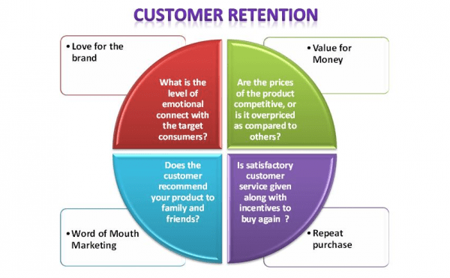
What is Customer Retention?
Customer retention refers to a company’s ability to turn customers into repeat buyers and prevent them from switching to a competitor. It indicates whether your product and the quality of your service please your existing customers. It’s also the lifeblood of most subscription-based companies and service providers
.

Slide 8
Why is Customer Retention Important?
Customer retention is an express route to a business’ financial success. It allows the companies to build long term, meaningful relationships with customers.
It empowers customers to share feedback with the company team.
It helps you understand how loyal and satisfied your customers are, how strong your customer service is, and your products are really worth their money or not.
It enhances the brand reputation and understands future needs of the customers.

Slide 9
Exploratory Data Analysis (EDA) Steps:
First, I have imported some of the important Libraries (numpy, pandas, matplotlib and seaborn).
I imported “customer retention” excel file in jupyter notebook.
Performed some of the statistical analysis like dimension of the dataset, data types, info, number of unique values, value counts, columns etc.
Checked the null values and found no null values in the dataset.
Performed visualization for each feature using seaborn and matplotlib libraries by plotting count plot, pie plot, distribution plot, box plot and factor plot.
.

Slide 10
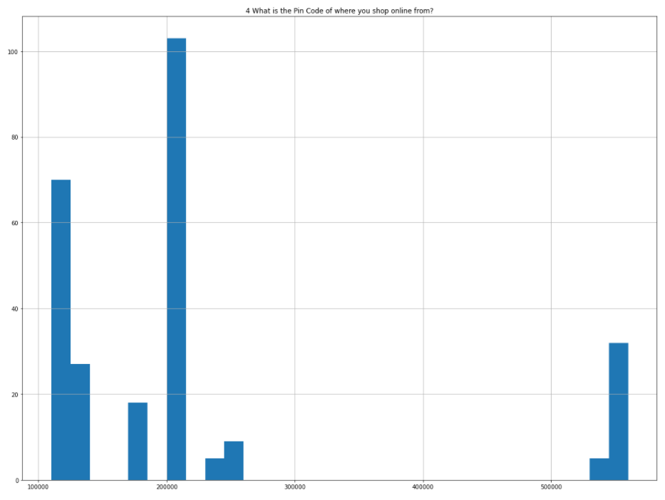
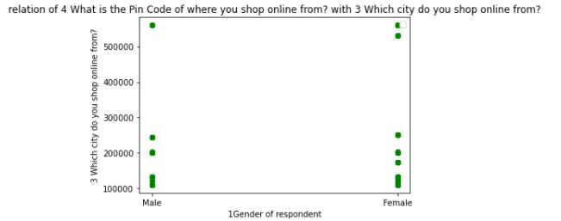
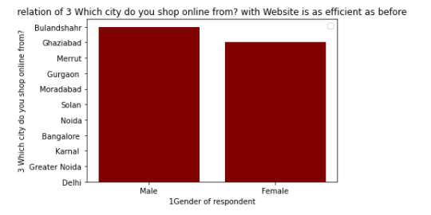
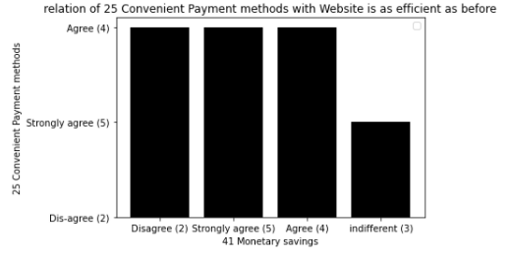

Slide 11
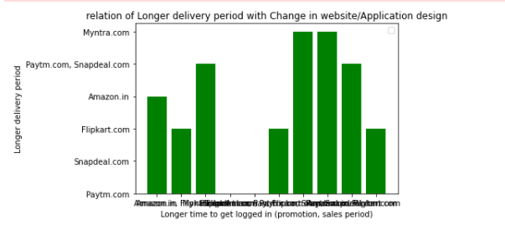
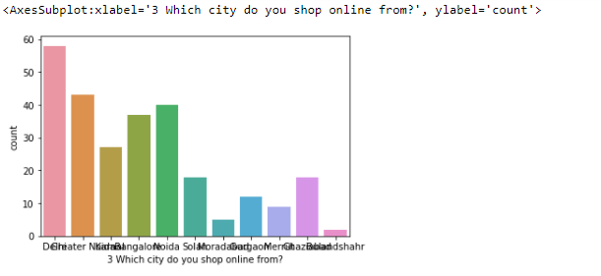
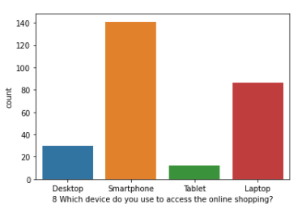
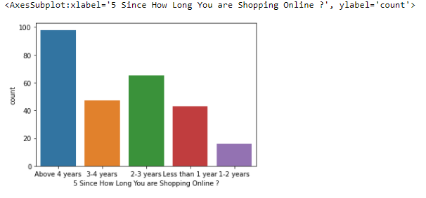

Slide 12
Conclusion:
Improving customer retention and building customer loyalty doesn’t happen overnight. It will take time and effort to grow your relationship with your customers and earn their trust.
Exceptional end-to-end customer experiences are the best way to earn customer trust. Provide great service and make customers’ lives easier, and they’ll likely turn into advocates for your brand.
Key factor is customer satisfaction. If customer get satisfied they will recommend the site to other. Which it self an advertisement.

Slide 13
Thank You…..☺

